Slide 1

Intelligent
Network Traffic Routing
For
UNIVERSITY NETWORK
A Graph Data Structure Based Solution for Real-Time Network Optimization

Slide 2




Networking Scenario
Multiple Buildings
Administrative Offices
Computer and Network
Laboratories
Central servers
(LMS & Internal Systems)
UNIVERSITY consist of

Slide 3

Computer lab
Sessions
Student WIFI
Usage
Heavy Network
Usage
Simultaneous LMS access
From Labs
Staff & Administrative
System access

Slide 4
The Real Networking Challenge
Network congestion occurs during peak hours
Some network paths become overloaded
Timeouts disrupt critical assessments
Slow LMS access
Delayed System Response
Reduced Lab productivity

Slide 5


PROBLEM STATEMENT
Lack of Intelligent Traffic Distribution
Traffic is routed through the same path
regardless of congestion
Traffic routed through least congested internal path

Slide 6


INNOVATION
Graph-Based Intelligent Traffic Routing System
Entire network is modeled as a
Weighted graph
Traffic routed through
least congested internal path
Automatic Path Optimization

Slide 7
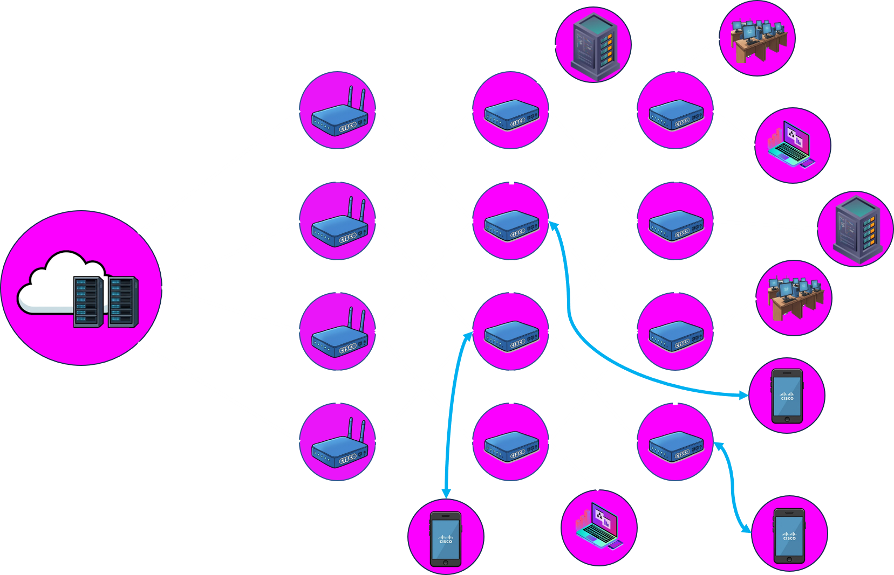
Graph Data Structure
GRAPH Data Structure

Slide 8
Algorithm Analysis
Algorithm uses an Adjacency List for
optimal space efficiency and traversal performance in complex network graphs.
O(V+E)
O(E log V)
Space Complexity
Time Complexity
Higher utilization and latency → Higher cost.
Compute edge weight as a composite score ;
weight = w1*utilization + w2*latency + w3*packet loss (normalize w1+w2+w3=1)

Slide 9

JUSTIFICATION
A Graph data structure allows efficient representation of multiple paths and dynamic selection of optimal routes.
Handles Network Complexity
Represents Congestion Dynamically
Campus networks are inherently non-linear with multiple interconnection points
Edge weights quantify congestion levels in real-time
Supports Path Comparison
Industry-Proven Approach
Based on real routing protocols like OSPF used in enterprise networks worldwide
Multiple routing paths exist between any two points

Slide 10

Action Items
Result
Design prototype topology and telemetry plan
Implement weight function and Dijkstra engine
Run pilot, measure KPIs (latency, throughput)
Enhanced Performance
Faster LMS access
Reduced exam portal failures
Significantly improved
student experience during
critical academic activities
Conclusion

